Slide 1
St Andrew’s Leaders PowerPoint Template
This template has been designed for Service Leaders to ensure compatibility with the rest of the systems used.
When adding or pasting in slides always choose the “Use Destination Theme (H)” option; never the “Keep Source Formatting (K)” option as this changes the underlying template and can cause problems.
When adding a new slide go to ‘Insert’ & then ‘New Slides’ to select the template that you want to use for the new slide.
The absolute minimum text size is 24 point Arial (ideally with Bold and Shadow enabled) in a good contrast for text to be visible from back of church.
The projection system in church in daylight means that the contrast will not be as good as viewed on your computer screen. Also avoid using borders as these can distort.
We use a 1024 x 768 display and any full screen images should be as close to this as possible for clarity.
Slides such as the welcome, readings and prayers slides are there purely as examples.

Slide 2
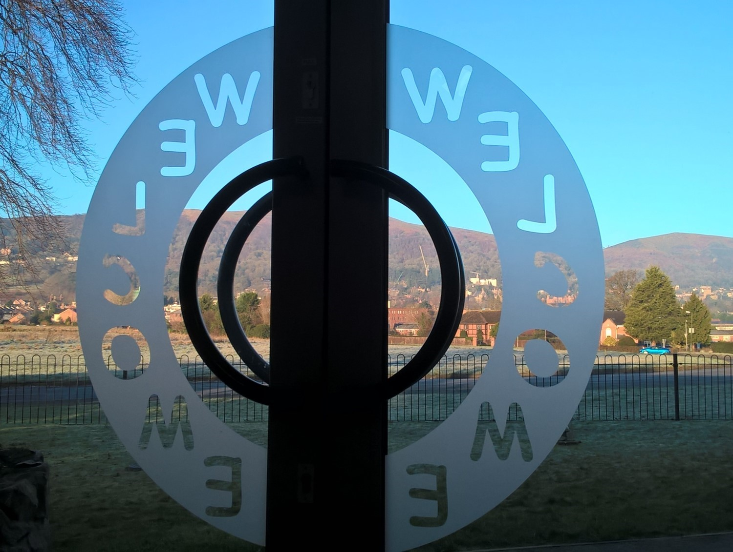

Slide 5
Blank Title Slide
Subtitles

Slide 6
Blank Title & Content Slide
Points
Points

Slide 7
Blank Slide

Slide 8
Normal Blank Slide on Blue Background

Slide 9
Blank Slide on a White Template

Slide 10
Blank slide on a Black Template

Slide 11
Happy birthday to you To Jesus be true May God’s richest blessings Be always with you
Congratulations

Slide 12
Acts 9:1-22 PAGE 1102
Acts 9:1-22 PAGE 1102

Slide 14
Let us pray

Slide 16
Let us pray the prayer Jesus taught us: Our Father in heaven, hallowed be your name, your kingdom come, your will be done, on earth as in heaven. Give us today our daily bread.

Slide 17
Forgive us our sins as we forgive those who sin against us. Lead us not into temptation but deliver us from evil. For the kingdom, the power, and the glory are yours now and for ever. Amen.

Slide 20
Prayer is available
by the Pulpit
Refreshments
in the Hall

